Slide 1
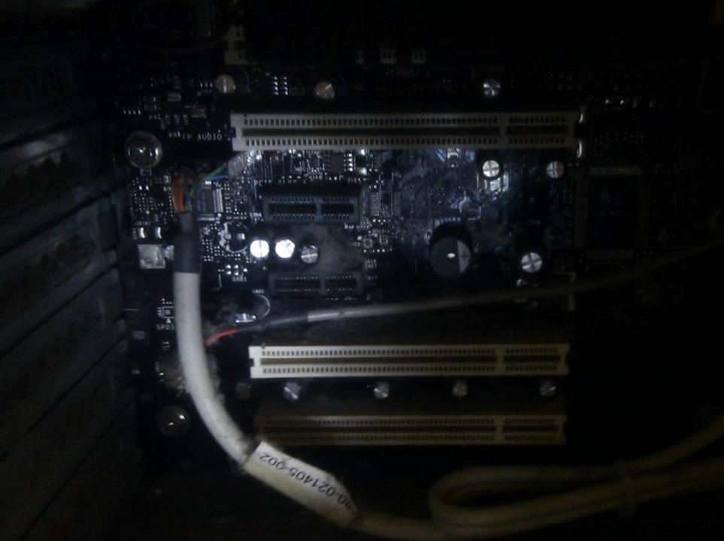
Computing Systems
Lecture 11
Micromen & Accidental Empires

Slide 2
The People Behind The Innovations
The machines and the software only tell a small part of the story
The stories of the people behind the computing revolution are also well worth learning...
  From Accidental Empires to The Social Network

Slide 3
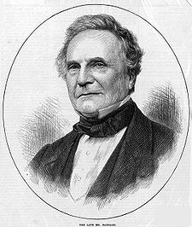
Charles Babbage
Designed early mechanical computers
  Difference Engine 1 & 2
  Analytical Engine
Limited uptake of Difference
Engine 1 in his lifetime
  But his ideas influenced other
  computing pioneers
“On two occasions I have been asked, "Pray, Mr. Babbage, if you put into the machine wrong figures, will the right answers come out?"”
Notes:
Also an eccentric figure – see http://en.wikipedia.org/wiki/Charles_babbage
The quote relates to a very well understood modern saying – Garbage In: Garbage Out. Without sensible input (data and program) a computer cannot generate sensible output
- Title link to video on Babbage

Slide 4

Ada Augusta, Countess of Lovelace
AKA Ada Lovelace
  Mathematically educated
  daughter of the poet Byron
Corresponded with Babbage
Wrote notes and a program for the (unbuilt) Analytical Engine
  Is often considered the first computer programmer
The programming language Ada is named after her
Died from cancer treatment aged 36

Slide 5
What was the first commercial use of an electronic digital computer?
Payroll calculations for a chain of tea-rooms?
Pharmaceutical company record keeping?
Geological modelling for oil surveying?
Long term financial forecasting for banks?
Tracking parts for a car manufacturer?

Slide 6
The worlds first commercial computer
Answer

Slide 7
20th Century Computing Pioneers
Research these figures in your own time
  What invention(s) were they involved in?
  What was the significance of this?
  How did this work influence the development of the computing field at the time? And in the following decades?
  What is the lasting impact of each pioneer’s work?
Plus lab exercise

Slide 8
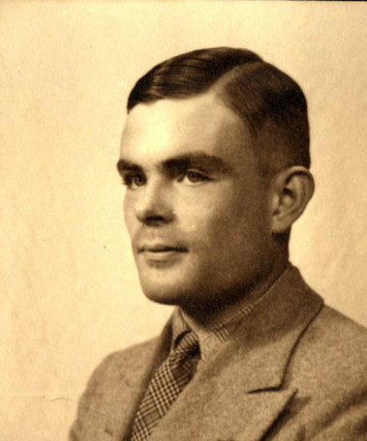
Alan Turing

Slide 9
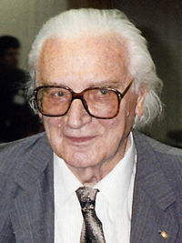
Konrad Zuse

Slide 10
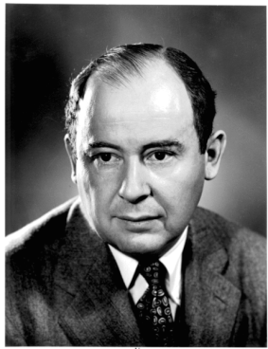
John von Neumann

Slide 11
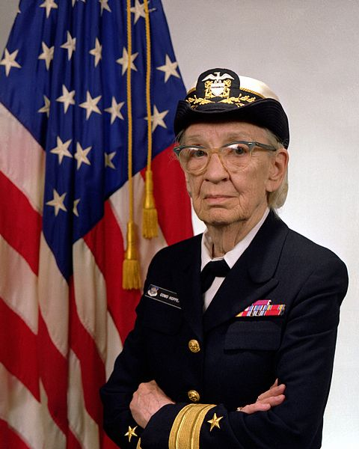
Grace Hopper

Slide 12
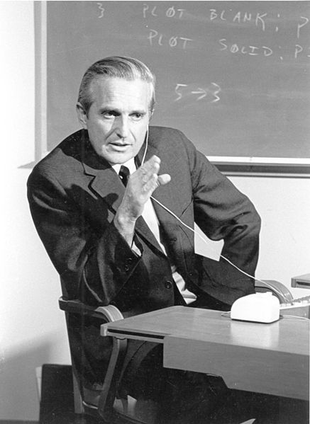
Douglas Engelbart

Slide 13
And some others...
Not for the exam... But of some interest!
  Computing for everyone: Taking computers from the science lab and office and leading their development into everyday appliances
  The internet – from concept to social networking

Slide 14
The Making of Colossus
The Making of Colossus
Team led not by Turing (though sometimes attributed to him), but by engineer Tommy Flowers
Notes:
Another ten minute video

Slide 15
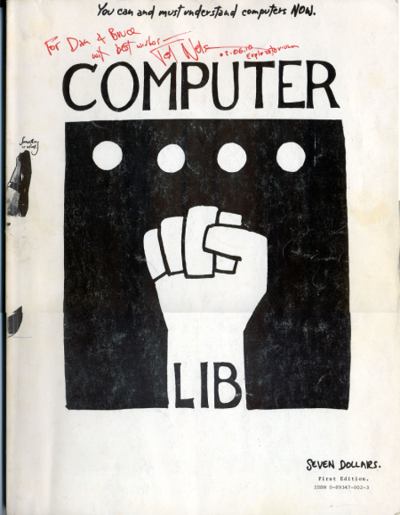
Ted Nelson
Influenced by Engelbart, further developed idea of hyperlinks
  Coined terms “hypertext” and “hypermedia”
Influential manifestos on personal computing mixing politics, philosophy and technology
  Driven by wanting to make computers accessible to ordinary people
Ideas more influential than his technical work
Notes:
Homepage at: http://ted.hyperland.com/
His autobiography, Possiplex, is available online and he has also written a history of computing – Geeks bearing Gifts

Slide 16
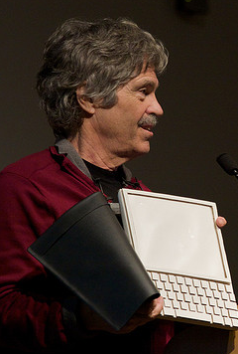
Xerox PARC & Alan Kay
Xerox PARC was a research group
  Alan Kay a notable figure at the group
Alan Kay and colleagues introduced term ‘Object Oriented Programming’ with Smalltalk – and also developed windows-based graphical user interfaces, laser printers, and networked
workstations
Kay conceived ‘Dynabook’, a precursor
of modern laptops & tablets
“The best way to predict the future is to
invent it” – Alan Kay
Notes:
Xerox PARC was hugely influential in the design of modern computers – but not so successful at commercialising the work. Apple paid Xerox for access to the lab, and it was on visits to the Xerox PARC that Apple discovered computer mice and windowing operating systems – which Apple then used in their Lisa and Mac computers. By this time, the patent on the computer mouse had almost expired, being almost 20 years old by then...

Slide 17
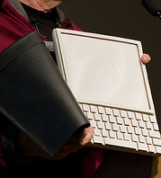
Dynabook
Conceived in 1968
Pad sized, portable computer (with pen input) for children to allow them to create their own programs
  Only a cardboard model was made!
Conceptual precursor of the
iPad and modern
ultra-light laptops
Notes:
Alan Kay’s Dynabook

Slide 18
Tim Berners-Lee
Inventor of the World-Wide Web
  Developed as a means to make it easier to share information across different systems connected via the internet
“The web is more a social creation than a technical one. I designed it for a social effect — to help people work together — and not as a technical toy. The ultimate goal of the Web is to support and improve our weblike existence in the world”

Slide 19
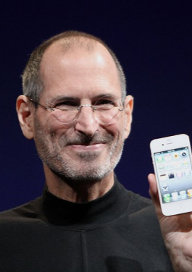
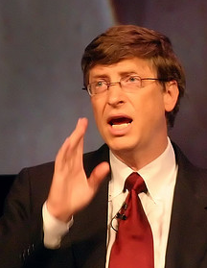
Steve Jobs & Bill Gates
Co-founders of Apple and Microsoft
  Two of the largest, most successful, companies on the planet
Success built on turning hardware &
software developments into
commercial successes
  Microsoft through selling compilers,
  operating systems and software
  Apple through selling computers
  (and controlling the operating system
  for their own computers)

Slide 20
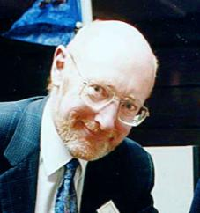
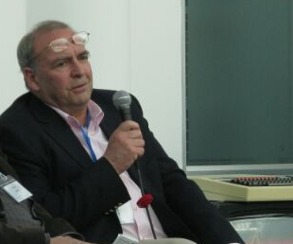
Clive Sinclair & Chris Curry
British home computing pioneers
  Sinclair & Acorn: Sinclair Spectrum & BBC Micro
  Created the first computers that went into many British homes (Spectrum) and schools (BBC)
Sinclair pioneered very low cost computing
Acorn also a pioneer in local area networking

Slide 21
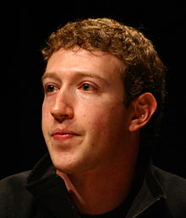
Marc Zuckerberg
Founder and original developer of Facebook
Subject of the film “The Social Network”
Several lawsuits have been
fought over Facebook
invention & shares

Slide 22

This work by Daniel Livingstone at the University of the West of Scotland is licensed under the Creative Commons Attribution-ShareAlike 3.0 Unported License. To view a copy of this license, visit http://creativecommons.org/licenses/by-sa/3.0/ or send a letter to Creative Commons, 171 Second Street, Suite 300, San Francisco, California, 94105, USA.
Image Credits:
Title Image – CC-BY-SA Daniel Livingstone, 2011
Computer Lib cover image: http://www.digibarn.com/collections/books/computer-lib/
Other photos sourced from WikiPedia
Charles Babbage image, public domain, http://en.wikipedia.org/wiki/File:Charles_Babbage_1860.jpg
Ada Lovelace image, public domain, http://en.wikipedia.org/wiki/File:Ada_Lovelace_color.svg
Alan Turing image, copyright unknown, http://www.turingarchive.org/browse.php/K/7/9-16
Konrad Zuse image, CC-BY-SA, by Wolfgang Hunscher, http://en.wikipedia.org/wiki/File:Konrad_Zuse_(1992).jpg
Von Neumann image, public domain, http://en.wikipedia.org/wiki/File:JohnvonNeumann-LosAlamos.gif, From Los Alamos National Laboratory: “Unless otherwise indicated, this information has been authored by an employee or employees of the University of California, operator of the Los Alamos National Laboratory under Contract No. W-7405-ENG-36 with the U.S. Department of Energy. The U.S. Government has rights to use, reproduce, and distribute this information. The public may copy and use this information without charge, provided that this Notice and any statement of authorship are reproduced on all copies. Neither the Government nor the University makes any warranty, express or implied, or assumes any liability or responsibility for the use of this information.”
Grace Hopper image, public domain, http://commons.wikimedia.org/wiki/File:Commodore_Grace_M._Hopper,_USN_(covered).jpg
Vannevar Bush image, public domain, http://en.wikipedia.org/wiki/File:Vannevar_Bush_portrait.jpg
Doug Engelbart image, public domain, http://commons.wikimedia.org/wiki/File:SRI_Douglas_Engelbart_1968.jpg
Xerox Alto computer image, public domain, http://en.wikipedia.org/wiki/File:Xerox_Alto_mit_Rechner.JPG
Alan Kay & Dynabook image, CC-BY Marcin Wichary, http://www.flickr.com/photos/8399025@N07/3010032738/
Steve Jobs image, CC-BY-SA Matt Yohe, http://en.wikipedia.org/wiki/File:Steve_Jobs_Headshot_2010-CROP.jpg
Bill Gates image, CC-BY-SA Kees de Vos, http://www.flickr.com/photos/devos/1512453/in/set-46183/
Clive Sinclair image, public domain by Adrian Pingstone, http://en.wikipedia.org/wiki/File:Sinclair.600pix.jpg
Chris Curry image, CC-BY-SA by Trevor Johnson, http://www.flickr.com/photos/97591625@N00/7020152303/
Mark Zuckerber image, CC-BY Jason McElweenie http://www.flickr.com/photos/99565773@N00/2323729121
Product names, logos, brands, and other trademarks featured or referred to within the these notes are the property of their respective trademark holders. These notes have been produced without affiliation, sponsorship or endorsement from the trademark holders.

